Slide 1
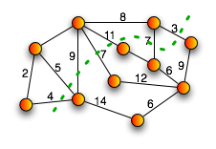

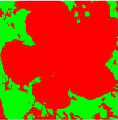
Parallel Max-Flow Min-Cut
Joshua Lee and Mona Huang

Slide 2
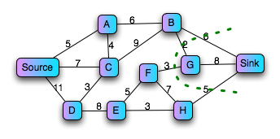
What is Max-Flow Min-Cut?
The maximum flow is the maximum amount of capacity that can pass from the source to the sink
The minimum cut is the set of edges with the smallest aggregate weight that can be removed from the graph so that no path exists from the source to the sink
Max Flow: 16
Max Flow = Min Cut

Slide 3
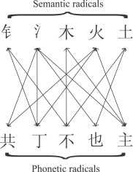
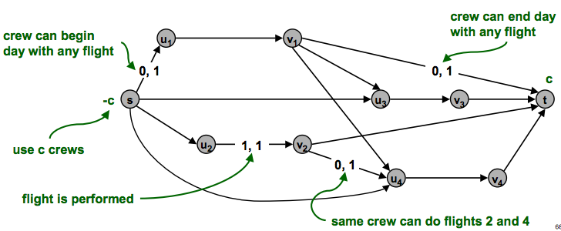
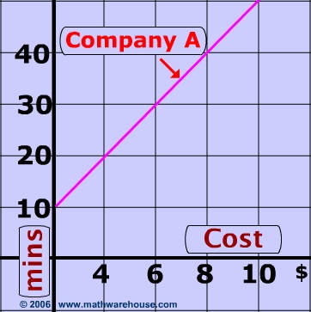
Motivation for MFMC
Several real life applications of max-flow min-cut
“Graphs” can get very large
Parallelizing can lead to speed ups and MFMC solutions for large graphs that do not fit in memory

Slide 4

Parallelizing Max-Flow
Major Challenges of Parallelization:
Deconstructing and reconstructing graph
Avoiding capacity constraint violation from multiple updates
Finding augmenting paths from the source to the sink without giving each processor a complete view of the graph
Maintaining a high level of parallelizable computation

Slide 5
Image Segmentation
Selection problems
Scheduling
Finding Nash Equilibrium
Image Segmentation !

